Slide 1
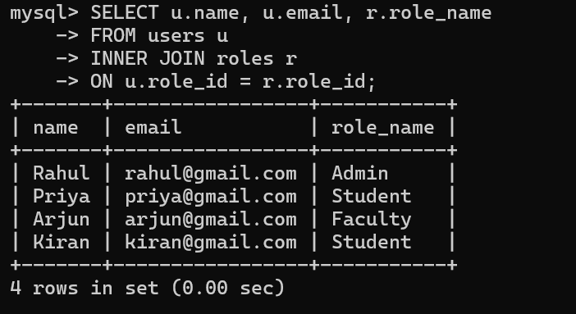
INNER JOIN

Slide 2
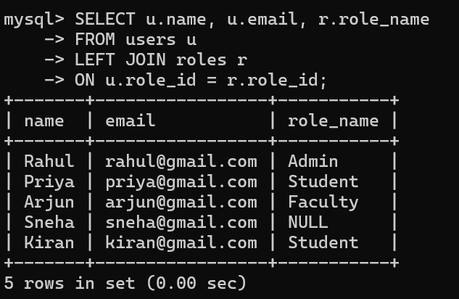
LEFT JOIN

Slide 3
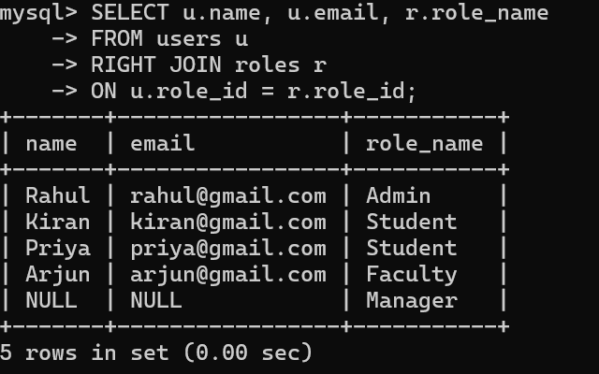
RIGHT JOIN

Slide 4
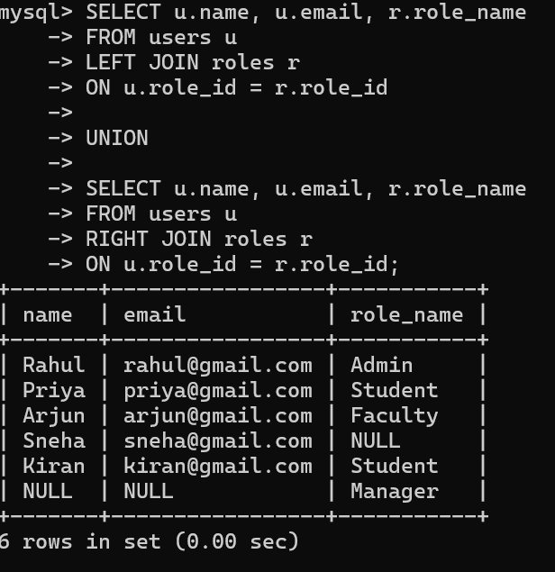
FULL JOIN

Slide 5
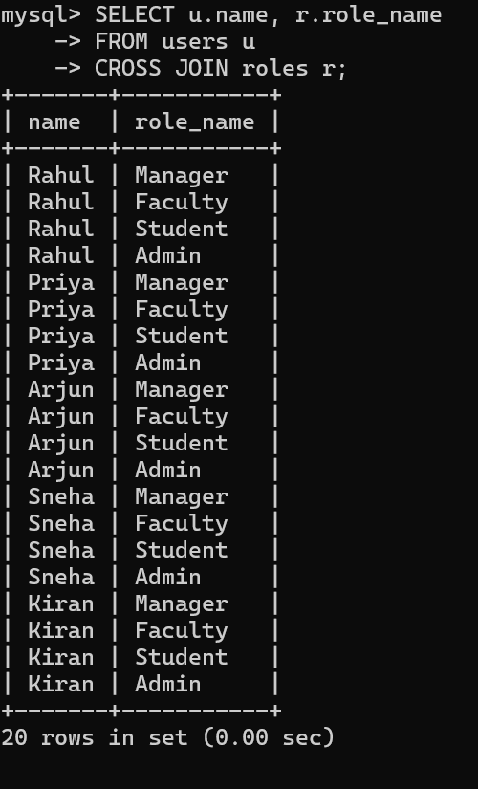
CROSS JOIN

Slide 6
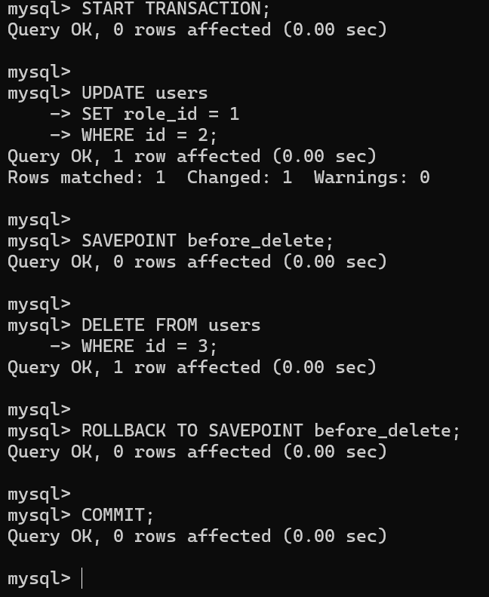
TCL Example – Task Hub

